Slide 1


DESIGN AND IMPLEMENTATION OF A ROBUST CONTROL SYSTEM FOR AUTONOMOUS VEHICLE MOTION USING LQR
Guide: Dr. Jitendra Sharma
Team Members:
A Pranathi 2210040004
D Soumya 2210040016
N Bhavana Sai 2210040028
E Anusha 2210040031
G Savi Sree 2210040035
Anu Sree 2210040050
Vidya Sree 2210040060

Slide 2
OVERVIEW
Key Challenge: Maintaining stability and trajectory tracking under disturbances such as road irregularities and model uncertainties.
Need for Robust Control: Traditional controllers fall short in handling uncertainties. Robust techniques like LQR offer a balance between tracking accuracy and control effort.
Project Focus:
Design and implementation of a robust control system using the Linear Quadratic Regulator (LQR).
Uses a kinematic bicycle model, linearized to suit optimal control design.
Objective: Achieve accurate trajectory tracking with minimal control effort using LQR, validated through Python simulations.

Slide 3
ABSTRACT
The increasing demand for reliable and efficient autonomous vehicles necessitates the development of advanced control systems that ensure stability, precision, and resilience in dynamic environments. This project addresses this need by designing and implementing a robust control strategy based on the Linear Quadratic Regulator (LQR) methodology. Using a kinematic bicycle model to represent the fundamental motion dynamics of an autonomous vehicle, the system is linearized around straight-line motion to enable optimal control design within a state-space framework.

Slide 4
INTRODUCTION
Autonomous vehicles are transforming the landscape of modern transportation, offering promising solutions in terms of safety, efficiency, and user convenience. However, the core challenge in autonomous vehicle development lies in designing a control system capable of guiding the vehicle precisely along a desired path while maintaining stability and robustness against disturbances such as road irregularities, environmental changes, and internal uncertainties. Conventional control methods often struggle with the nonlinearities and unpredictability inherent in vehicle dynamics, necessitating more sophisticated approaches.

Slide 5
PROBLEM
There is a pressing need for a robust and optimal control strategy that can maintain vehicle stability, minimize tracking errors, and efficiently manage control inputs. This project aims to address this problem by designing and implementing a Linear Quadratic Regulator (LQR)-based control system for autonomous vehicle motion, using a linearized kinematic bicycle model to achieve precise, stable, and efficient path tracking even in the presence of model uncertainties and external disturbances.

Slide 6
STEP BY STEP
1 Understand the physics of vehicle movement (build a dynamic model).
2 Choose a control strategy (MPC, Sliding Mode, LQR, etc.).
3 Implement path planning or provide pre-defined paths.
4 Design the controller in software (MATLAB, Python, ROS).
5 Simulate your controller under different conditions.
6 Evaluate robustness against disturbances and uncertainties.
7 (Optional) Test on a real small vehicle prototype.
8 Document results: stability analysis, performance graphs, error plots.

Slide 7
AUTONOMOUS VEHICLE SYSTEM ARCHITECTURE
1. Perception System
Uses cameras, LiDAR, and radar to detect lanes, obstacles, traffic signs, and moving objects.
2. Localization & Mapping
Combines GPS, IMU, and sensor fusion to determine position and build/update maps for navigation.
3. Planning Module
Plans safe and efficient routes, handling route selection, obstacle avoidance, and behavior decisions.
4. Control System
Generates steering, throttle, and brake commands using LQR for smooth motion and stability.
5. Actuation System
Executes control commands through steering, acceleration, and braking mechanisms.

Slide 8
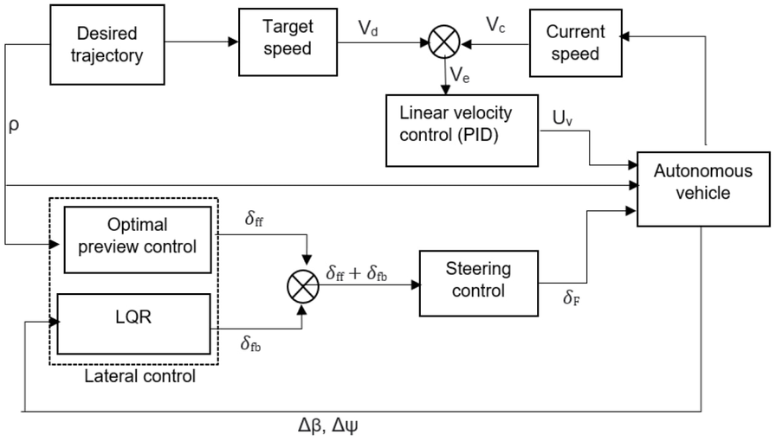
ARCHITECTURE
State-Space Model: Represents vehicle motion using position, speed, orientation, and control inputs like steering, acceleration, and braking.
LQR Control: Minimizes a cost function by balancing state errors and control efforts.
Real-Time Control: Continuously computes optimal inputs based on sensor data and vehicle state.
Robustness: Handles disturbances like friction and sensor noise to maintain stability.
Trajectory Planning: Follows desired path with high accuracy and energy efficiency.

Slide 9
DECISION-MAKING METHODS
LQR-Based Vehicle Control
Model-Based Control: Vehicle motion is represented in a state-space model (position, velocity, orientation). LQR uses this model for real-time decision-making.
Optimization Objective: LQR minimizes a cost function balancing state errors (path deviation) and control effort (steering, acceleration, braking).
Real-Time Decision-Making: Continuously computes optimal control inputs (e.g., steering, throttle) to follow the desired trajectory while minimizing cost.
Robustness to Disturbances: Adjusts to external disturbances (e.g., road conditions, wind) to maintain stability and minimize disruptions.
Balancing Trade-offs: Optimizes safety, comfort, and efficiency by balancing control effort and vehicle state (e.g., smoothness vs. quick response).

Slide 10
CONCLUSION
The LQR-based control system for autonomous vehicle motion has proven to be an effective solution for achieving precise, energy-efficient, and robust vehicle control. By optimizing control inputs in real-time, it ensures smooth trajectory tracking while maintaining stability in dynamic environments. The system's ability to minimize tracking errors and handle external disturbances makes it a promising approach for enhancing the reliability and performance of autonomous vehicles in real-world conditions.

Slide 11
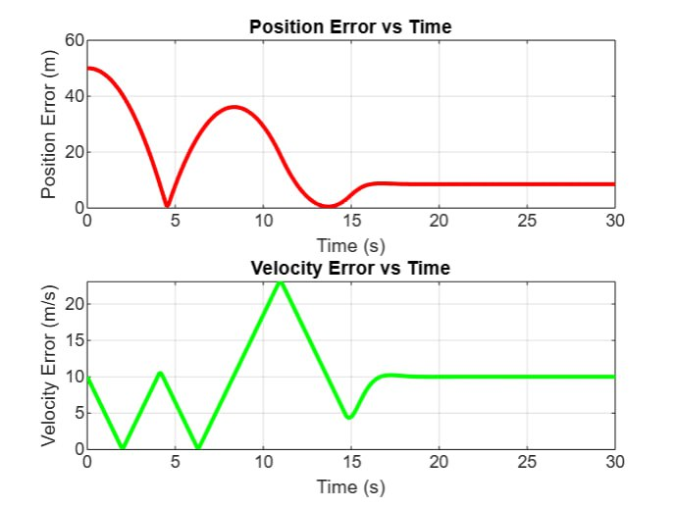
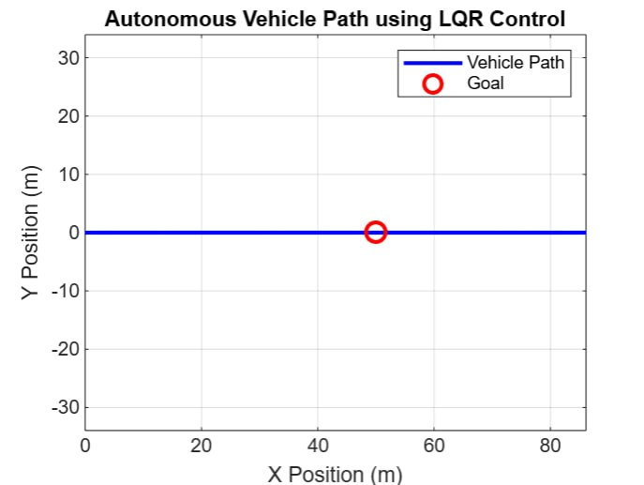
RESULTS

Slide 12
Thank You
For your attention

